Slide 1
Reactive Java Collections and Streams
James.Fennell@lit.ie

Slide 2
Important Java Features
Java9 introduced many concepts necessary for Reactive Programming
Private Interface Methods
Collection Factory Methods
Quick look at other Java9 Features – FYI only
Flow API
Reactive Programming in Java also relies heavily on the Java 8 Stream API

Slide 3
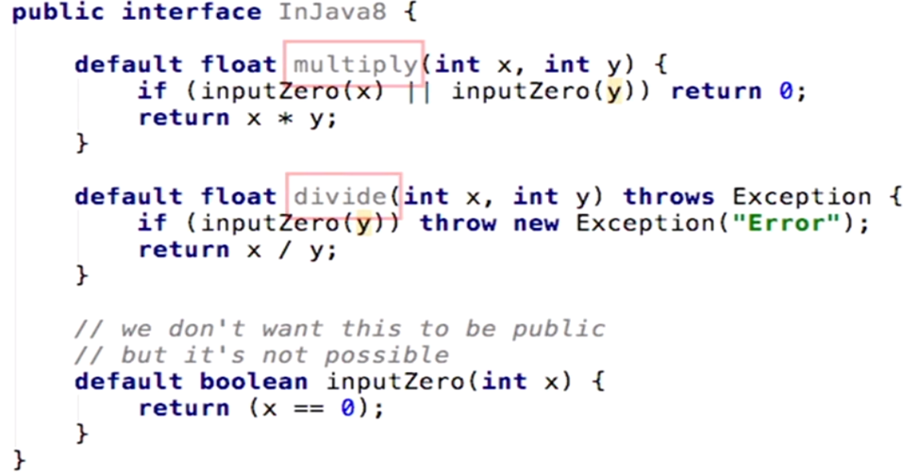
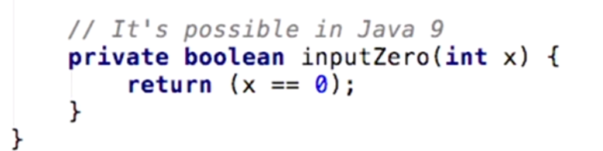
Private Interface Methods
In earlier Java versions you could not implement private methods in an interface
All methods had to be declared as default – were publicly available
Java 9 introduced the ability to have private methods in an interface
https://www.javatpoint.com/java-9-interface-private-methods

Slide 4
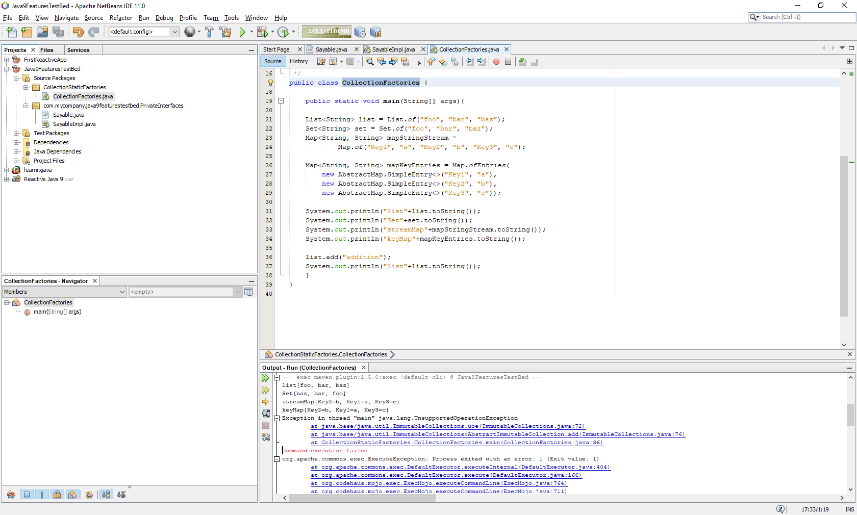
Collection Factory Methods
Java 9 also introduced some standard factory methods for the Collections interface
static methods have been provided for List, Set, and Map interfaces
take the elements as arguments and return an instance of List, Set and Map respectively.
https://www.baeldung.com/java-9-collections-factory-methods

Slide 5
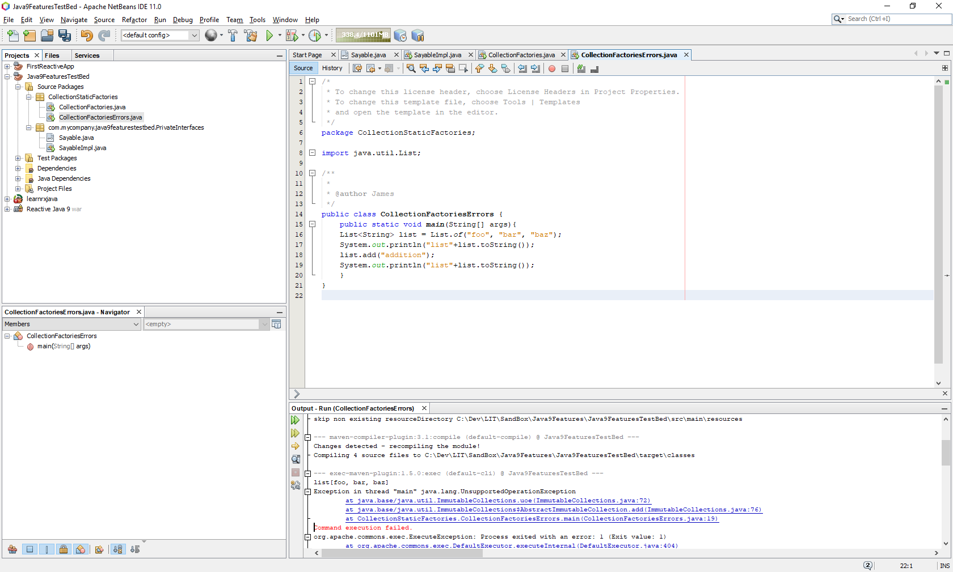
Collection Factory Methods Implementation
The collections created using factory methods are immutable
changing, adding or removing an element throws UnsupportedOperationException
No elements can be null
Passing null argument throws a NullPointerException:

Slide 6
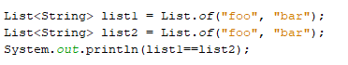
Collection Factory Methods Implementation
The instances created by factory methods are value based
This means that factories are free to create a new instance or return an existing instance
Not a big issue since the objects are immutable
Collections created from factory methods are Serializable if the elements of the collection are Serializable.
If we create Lists with same values, they may or may not refer to the same object on the heap:
In this case, list1 == list2 may or may not evaluate to true depending on the JVM

Slide 7
Other Java9 Features
Process API
Improving the management of operating system processes
Stack Walking
Access and filter information on stack traces
HTTP/2 Client
Project Jigsaw
JSON API
Multi resolution Imgae API
Platform Logging API
Datagram Transport Layer Security (DTLS)

Slide 8
Important Java8 Feature STREAMS API
Streams let you process data in a declarative way
streams leverage multicore architectures without having to write any multithread code!
Parallel processing is :
dividing your task into smaller subtask(s)
processing the subtask(s) in parallel
combining the results together to get the final output
Streams API provides a similar mechanism to work with Java collections
converting collections to a stream
processing the elements in parallel
gathering the resulting elements into a collection

Slide 9
Important Java8 Feature STREAMS vs Collections
Collections are a memory data structure which holds elements within it
Each element in the collection is computed before it actually becomes a part of that collection
Whether the application uses each particular value or not, all values will have been created
Streams are fixed data structures which computes the elements on demand basis
Java 8 Streams can be seen as lazily-constructed collections
values are computed when user demands it

Slide 10
Important Java8 Feature STREAMS vs Collections
Streams support pipelining and internal iterations
most stream operations returns a stream -> “easy function chaining”
Previously we used for loops or iterators to iterate through the collections
This kind of iteration is called an external iteration
they are clearly visible in the code
.

Slide 11
Important Java8 Feature STREAMS vs Collections
Streams support pipelining and internal iterations
most stream operations returns a stream -> “easy function chaining”
Previously we used for loops or iterators to iterate through the collections
This kind of iteration is called an external iteration
they are clearly visible in the code
Java 8 streams have methods like forEach, map, filter, et cetera,
internally iterates through the elements
If we take a look at the code
we are iterating over a list of animal - filtering those which starts with C
In the second image, we have the equivalent in a streamed way
We take the animal list and convert it to a stream
use different operators, such as map, which is going to return the name of the animal
we filter those with startsWith("C"), with the filter operator
Then we return the result as a list with a collect operator
doing exactly the same thing without any visible iteration logic - That's what is called internal iterations.

Slide 12
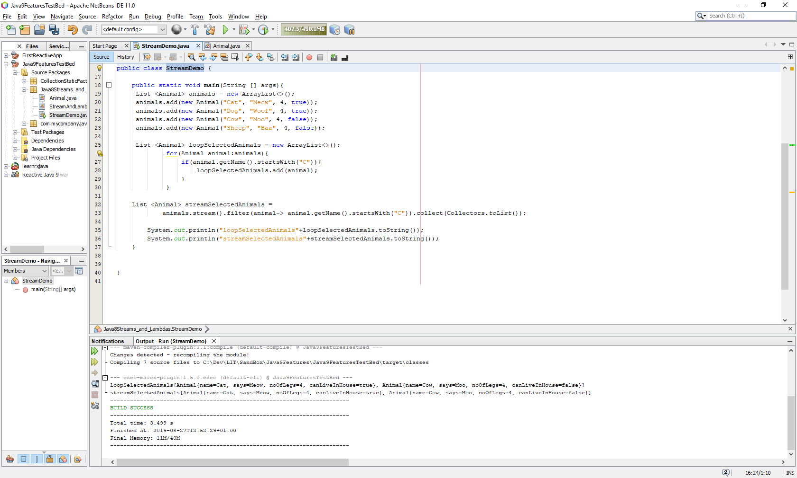
Important Java8 Feature STREAMS vs Collections
we are iterating over a list of animal - filtering those which starts with C
In the second method, we have the equivalent in a streamed way
We take the animal list and convert it to a stream
use different operators, such as map, which is going to return the name of the animal
we filter those with startsWith("C"), with the filter operator
Then we return the result as a list with a collect operator
doing exactly the same thing without any visible iteration logic - That's what is called internal iterations.

Slide 13
Important Java8 Feature STREAMS vs Collections
we are iterating over a list of animal - filtering those which starts with C
In the second method, we have the equivalent in a streamed way
We take the animal list and convert it to a stream
use different operators, such as map, which is going to return the name of the animal
we filter those with startsWith("C"), with the filter operator
Then we return the result as a stream with a collect operator
doing exactly the same thing without any visible iteration logic - That's what is called internal iterations.

Slide 14
Summary
Notes:
https://www.youtube.com/watch?v=dwP1TNXE6fc

